Slide 1
Java
Senthil Natarajan
Please Join in below link
Instagram: https://www.instagram.com/rba_infotech/
LinkedIn: https://www.linkedin.com/company/rba-infotech/
Facebook: https://www.facebook.com/people/RBA-Infotech/100043552406579/

Slide 2
Introduction to Java
It is a Object Oriented Programming (OOPs) language which was invented by James Gosling in 1995 in Sun Microsystem, later it became subsidy of Oracle. Before Java it was named Oak.
Advantages of Java
Object Oriented − In Java, everything is an Object. Java can be easily extended since it is based on the Object model.
Platform Independent − Unlike many other programming languages including C and C++, when Java is compiled, it is not compiled into platform specific machine, rather into platform independent byte code. This byte code is distributed over the web and interpreted by the Virtual Machine (JVM) on whichever platform it is being run on.
Simple − Java is designed to be easy to learn. If you understand the basic concept of OOP Java, it would be easy to master.
Secure − With Java's secure feature it enables to develop virus-free, tamper-free systems. Authentication techniques are based on public-key encryption.
Architecture-neutral − Java compiler generates an architecture-neutral object file format, which makes the compiled code executable on many processors, with the presence of Java runtime system.
Portable − Being architecture-neutral and having no implementation dependent aspects of the specification makes Java portable. Compiler in Java is written in ANSI C with a clean portability boundary, which is a POSIX subset.
Robust − Java makes an effort to eliminate error prone situations by emphasizing mainly on compile time error checking and runtime checking.

Slide 3
Procedural vs Object Oriented Programming Language
PROCEDURAL ORIENTED PROGRAMMING | OBJECT ORIENTED PROGRAMMING
In procedural programming, program is divided into small parts called functions. | In object oriented programming, program is divided into small parts called objects.
Procedural programming follows top down approach. | Object oriented programming follows bottom up approach.
There is no access specifier in procedural programming. | Object oriented programming have access specifiers like private, public, protected etc.
Adding new data and function is not easy. | Adding new data and function is easy.

Slide 4
Contd…
PROCEDURAL ORIENTED PROGRAMMING | OBJECT ORIENTED PROGRAMMING
Procedural programming does not have any proper way for hiding data so it is less secure. | Object oriented programming provides data hiding so it is more secure.
In procedural programming, overloading is not possible. | Overloading is possible in object oriented programming.
In procedural programming, function is more important than data. | In object oriented programming, data is more important than function.
Procedural programming is based on unreal world. | Object oriented programming is based on real world.
Examples: C, FORTRAN, Pascal, Basic etc. | Examples: C++, Java, Python, C# etc.

Slide 5
C++ vs Java
COMPARISON PARAMETER | C++ | JAVA
Developed / Founded by | C++ was developed by Bjarne Stroustrup at Bell Labs in 1979. It was developed as an extension of the C language. | Java was developed by James Gosling at Sun Microsystems. Now, it is owned by Oracle.
Programming model | It has support for both procedural programming and object-oriented programming. | Java has support only for object-oriented programming models.
Platform dependence | C++ is platform dependent. It is based on the concept of Write Once Compile Anywhere. | Java is platform-independent. It is based on the concept of Write Once Run Anywhere.
Features supported | C++ supports features like operator overloading, Goto statements, structures, pointers, unions, etc. | Java does not support features like operator overloading, Goto statements, structures, pointers, unions, etc.
Compilation and Interpretation | C ++ is only compiled and cannot be interpreted. | Java can be both compiled and interpreted.
Library and Code reusability support | C++ has very limited libraries with low-level functionalities. C++ allows direct calls to native system libraries. | Java, on the other hand, has more diverse libraries with a lot of support for code reusability. In Java, only calls through the Java Native Interface and recently Java Native Access are allowed.
Memory Management | In C++, memory management is manual. | In Java, memory management is System controlled.
Type semantics | C++ is pretty consistent between primitive and object types. | In Java, semantics differs for primitive and object types.
Global Scope | In C++, both global and namespace scopes are supported. | Java has no support for global scope.
Access control and object protection | In C++, a flexible model with constant protection is available. | In Java, the model is cumbersome and encourages weak encapsulation.

Slide 6
C++ vs Java
COMPARISON PARAMETER | C++ | JAVA
Features supported | C++ supports features like operator overloading, Goto statements, structures, pointers, unions, etc. | Java does not support features like operator overloading, Goto statements, structures, pointers, unions, etc.
Compilation and Interpretation | C ++ is only compiled and cannot be interpreted. | Java can be both compiled and interpreted.
Library and Code reusability support | C++ has very limited libraries with low-level functionalities. C++ allows direct calls to native system libraries. | Java, on the other hand, has more diverse libraries with a lot of support for code reusability. In Java, only calls through the Java Native Interface and recently Java Native Access are allowed.
Memory Management | In C++, memory management is manual. | In Java, memory management is System controlled.
Type semantics | C++ is pretty consistent between primitive and object types. | In Java, semantics differs for primitive and object types.
Global Scope | In C++, both global and namespace scopes are supported. | Java has no support for global scope.
Access control and object protection | In C++, a flexible model with constant protection is available. | In Java, the model is cumbersome and encourages weak encapsulation.

Slide 7
C++ vs Java
COMPARISON PARAMETER | C++ | JAVA
Memory Management | In C++, memory management is manual. | In Java, memory management is System controlled.
Type semantics | C++ is pretty consistent between primitive and object types. | In Java, semantics differs for primitive and object types.
Global Scope | In C++, both global and namespace scopes are supported. | Java has no support for global scope.
Access control and object protection | In C++, a flexible model with constant protection is available. | In Java, the model is cumbersome and encourages weak encapsulation.

Slide 8
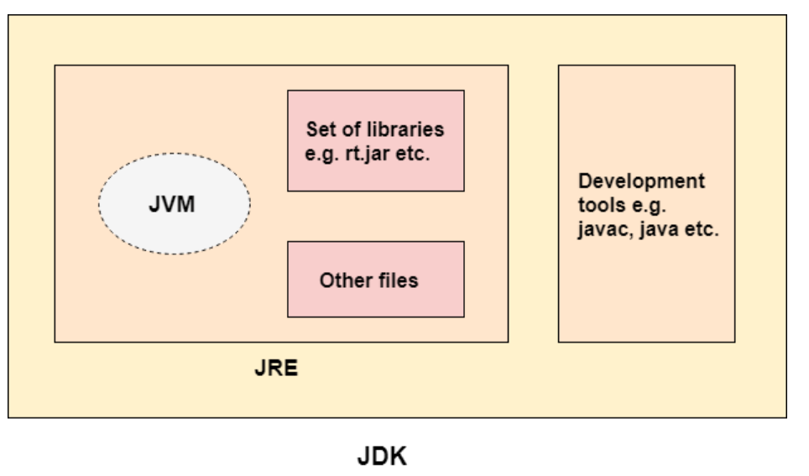
JDK vs JRE vs JVM

Slide 9
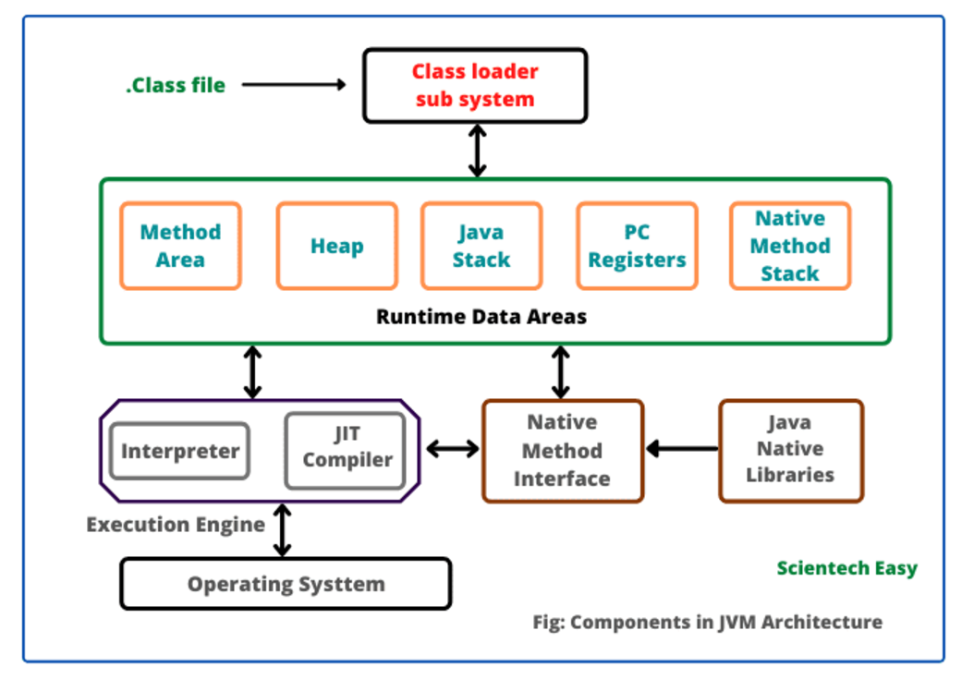
JVM Architecture

Slide 10
Structure of Java Program
Documentation Section
Package Statement
Import Statements
Class Definition
Main Method Class
  Main Method Definition

Slide 11
Structure of Java Program
Ex.
Hello.java
/* Author: Senthil
Date: 202-01-07
Description: Writes the words "Hello Java" on the screen */
public class Hello
{
public static void main(String[] args)
{
System.out.println("Hello Java");
}
}

Slide 12
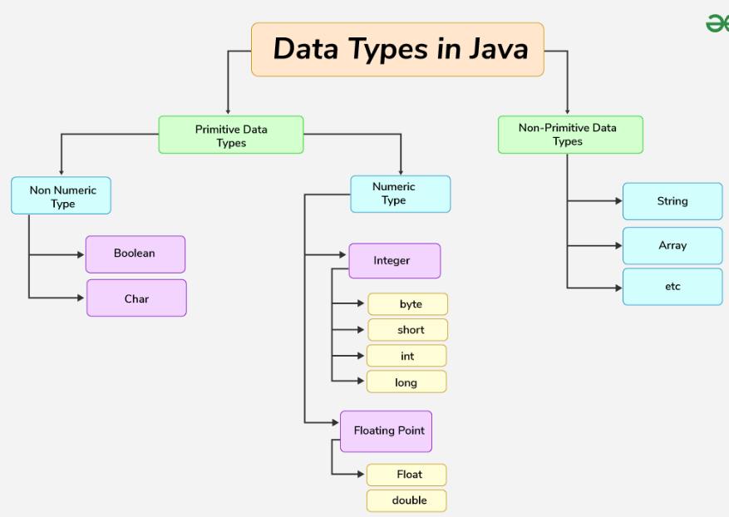
Data Types

Slide 13
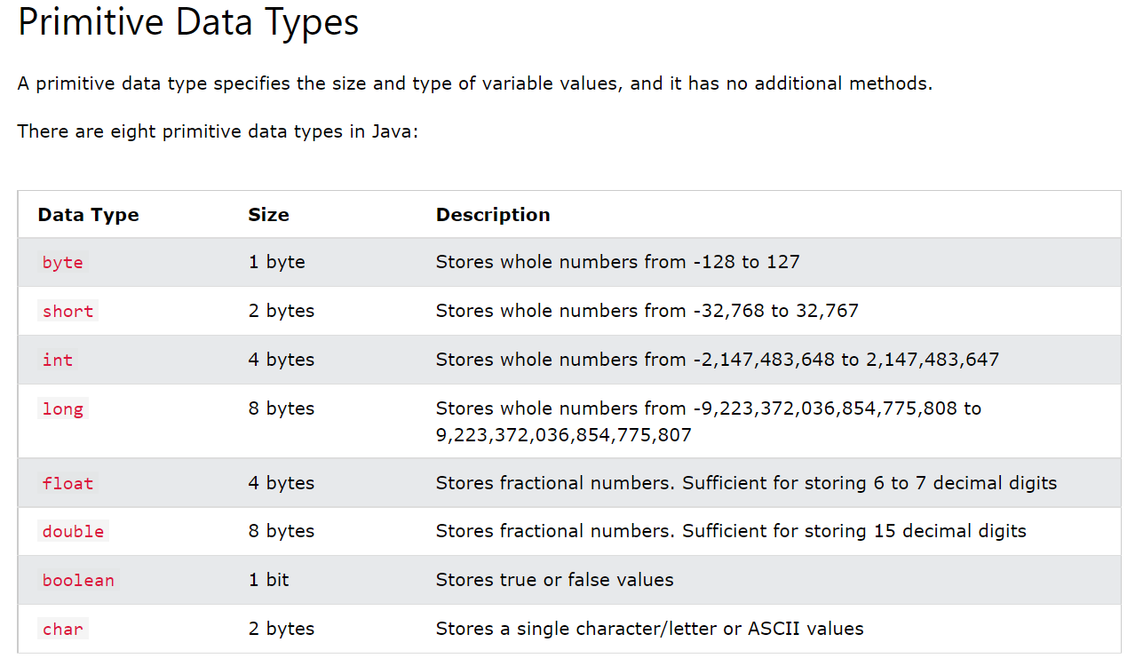

Slide 14
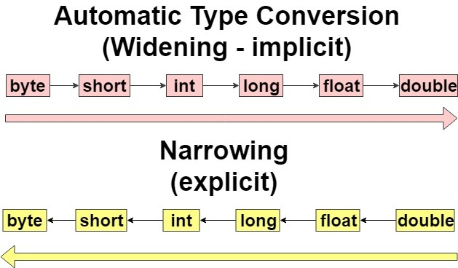
Type Casting

Slide 15
Java Naming Conventions
Class
It should start with the uppercase letter. In case of more than one words first letter of each word should be capital letter.
It should be a noun such as Color, Button, System, Thread, etc.
Use appropriate words, instead of acronyms.
Example: -
public class EmployeeDetails
{
//code snippet
}

Slide 16
Java Naming Conventions
Variable
It should start with a lowercase letter such as id, name.
It can start with only two special characters $ (dollar) and _ (underscore), other special characters are not allowed.
If the name contains multiple words, first letter of first word should be small case and first letter of remaining words should be upper case such as firstName, lastName.
Avoid using one-character variables such as x, y, z.
Example :-
class Employee
{
//variable
int id;
Int empNo;
//code snippet
}

Slide 17
Java Naming Conventions
Method
It should start with lowercase letter.
It should be a verb form such as main(), print(), println().
If method name is multiple words, first letter of the first word should be in small case and first letter of the remaining words should be upper case.
e.x: actionPerformed().
Example:-
class Employee
{
//method
void draw()
{
//code snippet
}
}

Slide 18
Java Naming Conventions
Constant
It should be in uppercase letters such as RED, YELLOW.
If the name contains multiple words, it should be separated by an underscore(_) such as MAX_PRIORITY.
It may contain digits but not as the first letter.
Example :-
class Employee
{
//constant
static final int MIN_AGE = 18;
//code snippet
}

Slide 19
Java Naming Conventions
Interface
It should start with the uppercase letter.
It should be an adjective such as Runnable, Remote, ActionListener.
Use appropriate words, instead of acronyms.
Example: -
interface Printable
{
//code snippet
}

Slide 20
Java Naming Conventions
Package
It should be a lowercase letter such as java, lang.
If the name contains multiple words, it should be separated by dots (.) such as java.util, java.lang, com.demo
Example :-
package com.javatpoint; //package
class Employee
{
//code snippet
}

Slide 21
Java Naming Conventions
CamelCase in java naming conventions
Java follows camel-case syntax for naming the class, interface, method, and variable.
If the name is combined with two words, the second word will start with uppercase letter always such as actionPerformed(), firstName, ActionEvent, ActionListener, etc.

Slide 22
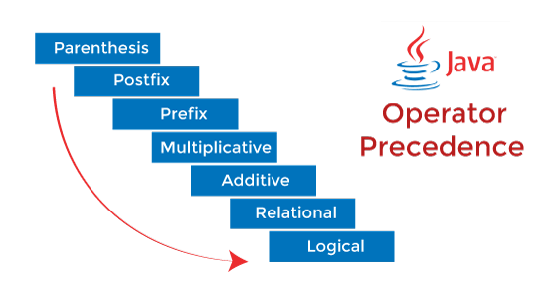
Operators Precedence

Slide 23
Operators
Operator Type | Category | Precedence
1. Arithmetic | Multiplicative | *, /, %
 | Addictive | +, -
2. Relational | Comparison | <, <=, >, >=
 | Equality | ==, !=
3. Logical | And | &&
 | Or | ||
 | Not | !
4. Unary | Postfix | expr++, expr– Ex. i++, j--
 | Prefix | ++expr, --expr Ex. --i, --j
5. Ternary |  | (condition)? Stt : Stt
6. Bitwise | Bitwise And | &
 | Bitwise Or | |
 | Bitwise Exclusive Or | ^
7. Shift |  | <<, >>
8. Assignment |  | =, +=,-+,*=,/+,%=, &=, !=, ^=, <<=, >>=

Slide 24
Precedence | Operator | Type | Associativity
15 | () [] · | Parentheses Array subscript Member selection | Left to Right
14 | ++ -- | Unary post-increment Unary post-decrement | Right to left
13 | ++ -- + - ! ~ (type) | Unary pre-increment Unary pre-decrement Unary plus Unary minus Unary logical negation Unary bitwise complement Unary type cast | Right to left
12 | * / % | Multiplication Division Modulus | Left to right

Slide 25
Precedence | Operator | Type | Associativity
11 | + - | Addition Subtraction | Left to right
10 | << >> >>> | Bitwise left shift Bitwise right shift with sign extension Bitwise right shift with zero extension | Left to right
9 | < <= > >= instanceof | Relational less than Relational less than or equal Relational greater than Relational greater than or equal Type comparison (objects only) | Left to right
8 | == != | Relational is equal to Relational is not equal to | Left to right

Slide 26
Precedence | Operator | Type | Associativity
7 | & | Bitwise AND | Left to right
6 | ^ | Bitwise exclusive OR | Left to right
5 | | | Bitwise inclusive OR | Left to right
4 | && | Logical AND | Left to right
3 | || | Logical OR | Left to right
2 | ? : | Ternary conditional | Right to left
1 | = += -= *= /= %= | Assignment Addition assignment Subtraction assignment Multiplication assignment Division assignment Modulus assignment | Right to left

Slide 27
Precedence | Operator | Type | Associativity
15 | () [] · | Parentheses Array subscript Member selection | Left to Right
14 | ++ -- | Unary post-increment Unary post-decrement | Right to left
13 | ++ -- + - ! ~ (type) | Unary pre-increment Unary pre-decrement Unary plus Unary minus Unary logical negation Unary bitwise complement Unary type cast | Right to left
12 | * / % | Multiplication Division Modulus | Left to right

Slide 28
Statements
Statements
If else
For loop
For each
While loop
Do … while loop
Switch… case
Break
Continue

Slide 29
For each loop
is another array traversing technique like for loop, while loop, do-while loop
Syntax:
  for( datatype var : array or collection)
  {
  Stt;
  }

Slide 30
Java String

Slide 31
String
String is collection of characters.
Ex:
String s1 = “Selenium”
String s2 = “Selenium”
The String is immutable. The String value cannot be changed.
How to create a string object?
There are two ways to create String object.
By string literal
Ex:
String s1 = “Selenium”
By new keyword
Ex:
String s2 = new String(“Selenium”);

Slide 32
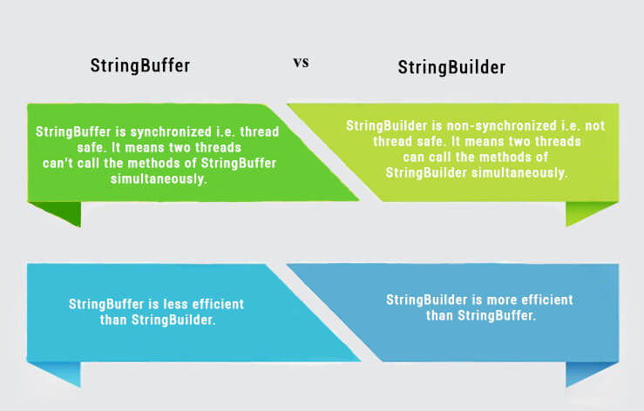
String vs StringBuffer vs StringBuilder

Slide 33
Compare Two Strings
By equals() method
  Compares content of two strings
By = = operator
  Compares reference not values
By compareTo() method
  Compares values lexicographically and returns an integer value

Slide 34
Arrays
Collection of Similar data types
There are two types of array.
Single Dimensional Array
Multidimensional Array
Syntax to Declare Array:
dataType[] arr; (or)
dataType []arr; (or)
dataType arr[];
Syntax to Instantiation of an Array in Java
arrayRefVar=new datatype[size];
Syntax to Declare and Instantiate of an Array
datatype[] arrayRefVar=new datatype[size];

Slide 35
OOPs – Object Oriented Programming
The following 4 concepts are the features of the OOPs
Access Modifier / Access Specifier
Class
Object
Encapsulation
Inheritance
Polymorphism
Abstraction
  Abstract Class
  Interface

Slide 36
OOPs – Object Oriented Programming
The few other concepts of the OOPs
Constructor
Package
static
final
this keyword
super

Slide 37
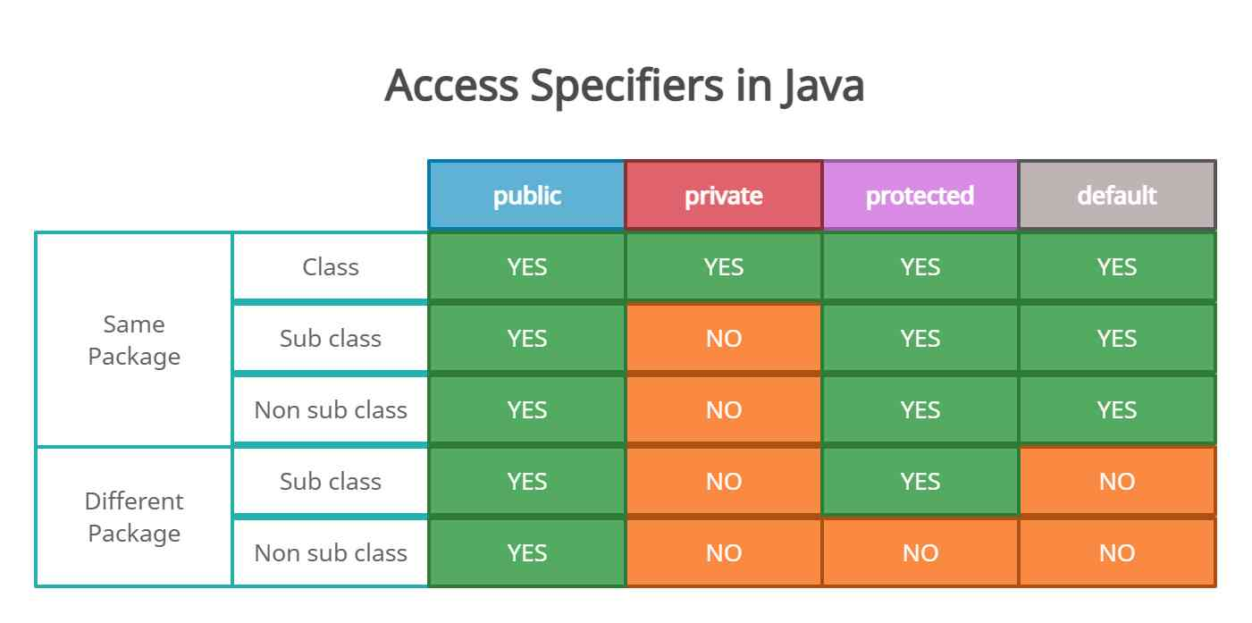
Access Modifiers / Access Specifiers

Slide 38
Variable Type | Declared In | Scope | Stored In | Default Value
Local | Inside method | Method/block only | Stack | None (must init)
Instance | Inside class | Whole object | Heap | Yes
Static | Inside class | Entire class | Method area | Yes
Parameter | Method signature | Method/block only | Stack | Must be passed

Slide 39
OOPs – Object Oriented Programming
The following 4 concepts are the features of the OOPs
Abstraction
Encapsulation
  Binding the data member and member functionality into single unit is called
Inheritance
  Deriving the properties from one class to anther class
Polymorphism
  Performing many actions with one name
  1. Method Overloading
  2. Method Overriding

Slide 40
Abstract Class and Interface
Data Abstraction
Abstract Class – Partial Abstraction ( 0 -100%)
Interface – Full Abstraction ( 100%)

Slide 41
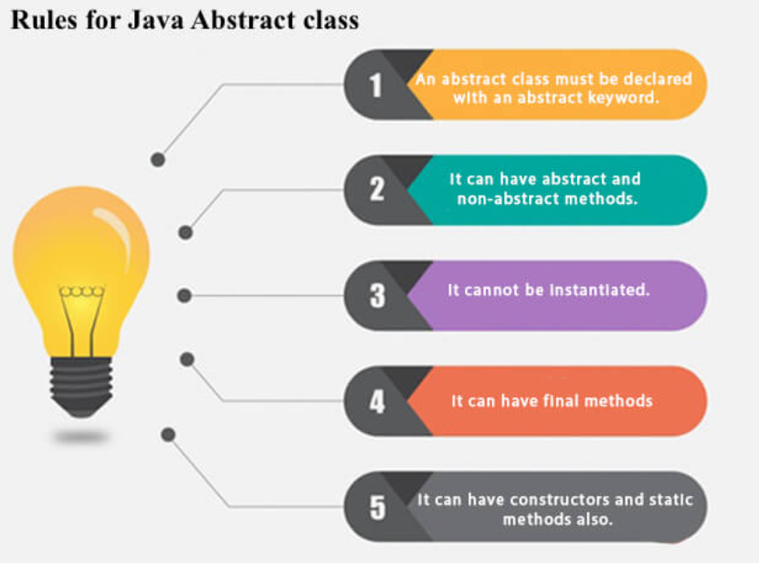
Abstract Class

Slide 42
Interface
What is Interface?
It is contains variable and only abstract methods.
public interface Employeeable {
String empName="Senthil";
void showEmpDetails();
}

Slide 43
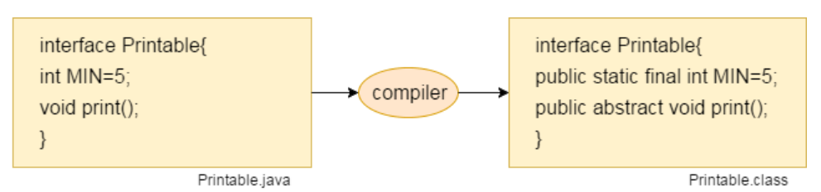
Interface

Slide 44
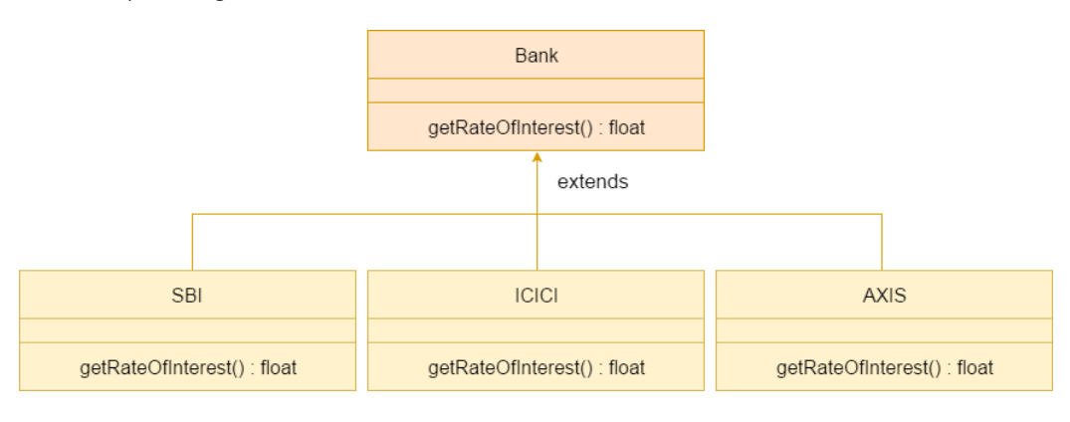
Implements

Slide 45
Abstract Class vs Interface
Abstract class | Interface
1) Abstract class can have abstract and non-abstract methods. | Interface can have only abstract methods. Since Java 8, it can have default and static methods also.
2) Abstract class doesn't support multiple inheritance. | Interface supports multiple inheritance.
3) Abstract class can have final, non-final, static and non-static variables. | Interface has only static and final variables.
4) Abstract class can provide the implementation of interface. | Interface can't provide the implementation of abstract class.
5) The abstract keyword is used to declare abstract class. | The interface keyword is used to declare interface.
6) An abstract class can extend another Java class and implement multiple Java interfaces. | An interface can extend another Java interface only.
7) An abstract class can be extended using keyword "extends". | An interface can be implemented using keyword "implements".
8) A Java abstract class can have class members like private, protected, etc. | Members of a Java interface are public by default.

Slide 46
Package
What is Package?
Package is the pack of classes, interfaces and other packages.
Two Types of Package:
Pre-defined or Built-in Packages
User-Defined Packages
Build-In Package:
java.util.Scanner;
Here:
→ java is a top level package
→ util is a sub package
→ and Scanner is a class which is present in the sub package util.

Slide 47
Package
Why Packages?
Reusability
Better Organization
Name Confilicts
Ways to access the Package from another Package
import package.*;
Ex: import java.util.*;
import package.classname;\
  import java.util.Scanner;
fully qualified name.
  java.util.Scanner sc = new java.util.Scanner();

Slide 48
Exception Handling
What is Exception?
An Exception is an unexpected event that interrupts the normal execution flow of the program. When an exception occurs program execution gets terminated.
In such cases we get a system generated error message.
The good thing about exceptions is that they can be handled in Java.
By handling the exceptions we can provide a meaningful message to the user about the issue rather than a system generated message, which may not be understandable by user.

Slide 49
Exception Handling
Why Exception occurs?
There can be several reasons that can cause a program to throw exception.
For example:
  Opening a non-existing file in your program
  Bad input data provided by user.
  Accessing the array elements out of the index range.

Slide 50
Syntax for Handling Exception
Syntax:
try{
// code snippet which causes exception
}catch(approriate exception a){
System.out.println(“Exception occured”);
}
Ex:
  try{
  A = 10/0;
  }catch(ArithmeticException ae){
  System.out.println(“Divided by zero exception occured”);
  }

Slide 51
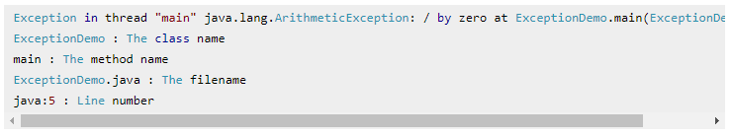
System vs User generated Exception Message
The below is the system generated exception
The below is the user defined exception message
The number is divided by zero on line no 5.

Slide 52
Types of Exception
      Two Types:
      Checked Exception / Compile time exception
      Unchecked Exception / Runtime exception
      Checked Exception
      The compiler checks the programme during compilation to see whether the programmer has handled them or not.
      If these exceptions are not handled/declared in the program, you will get compilation error. For example, SQLException, IOException, ClassNotFoundException etc
      All exceptions other than Runtime Exceptions are known as Checked exceptions as
      Unchecked Exception
      These exceptions are not checked at compile-time so compiler does not check whether the programmer has handled them or not.
      Runtime Exceptions are also known as Unchecked Exceptions.

Slide 53
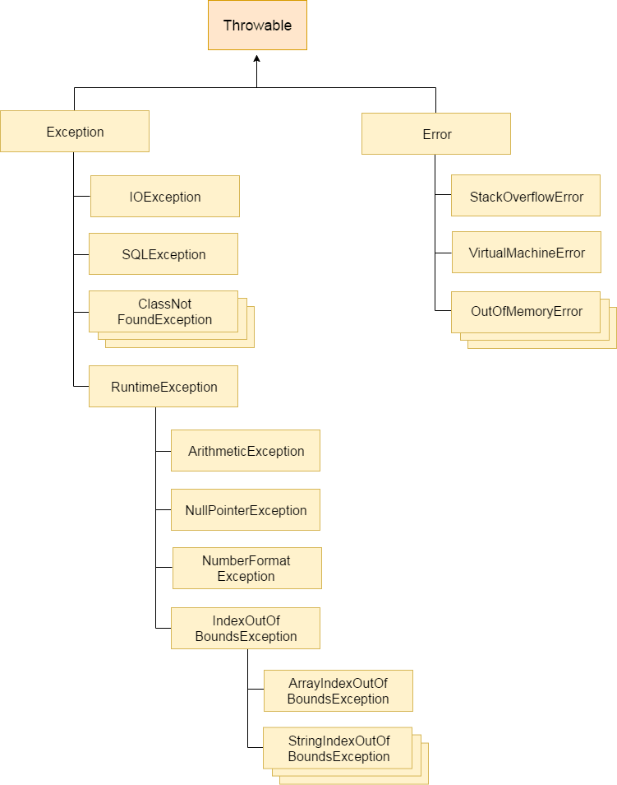
Hierarchy of Exception Class

Slide 54
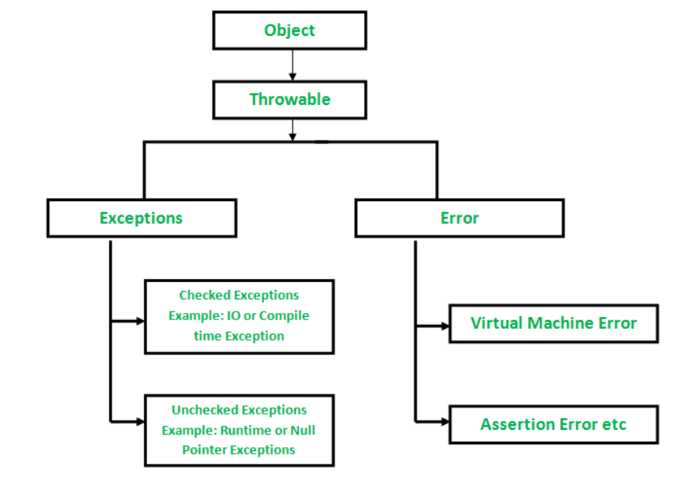

Slide 55
Difference between Error and Exception
      Error:
      Indicate that something severe enough has gone wrong.
      The application should crash rather than try to handle the error.
        Ex:
        Memory out of the error
        Stack Trace Error
      Exceptions
      They are events that occurs in the code.
      A programmer can handle such conditions and take necessary corrective actions
      E.x:
        Arithmetic Exception
        IOException
        NullPointer Exception

Slide 56
Multithreading
Multithreading is a Java feature that allows concurrent execution of two or more parts of a program for maximum utilization of CPU. Each part of such program is called a thread. So, threads are light-weight processes within a process.
hreads can be created by using two mechanisms :
Extending the Thread class
Implementing the Runnable Interface

Slide 57
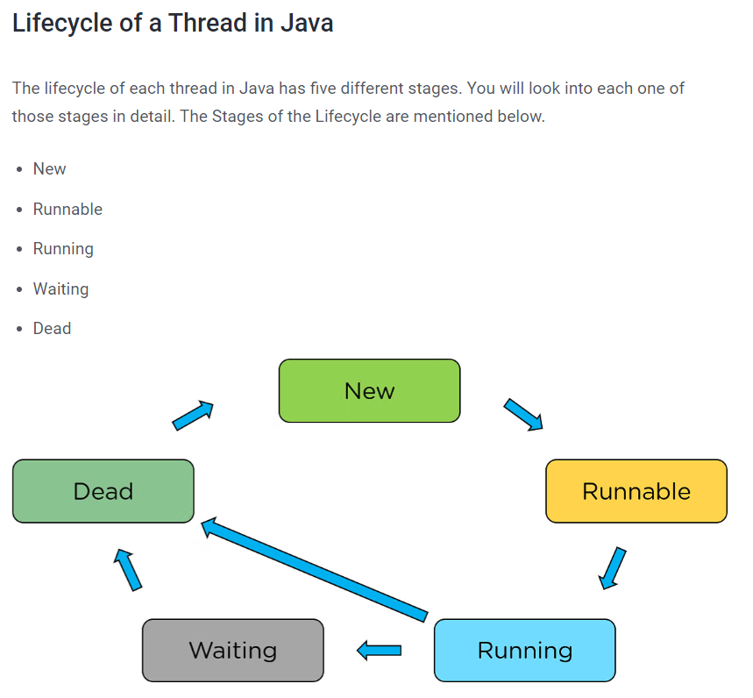
Thread Life Cycle

Slide 58
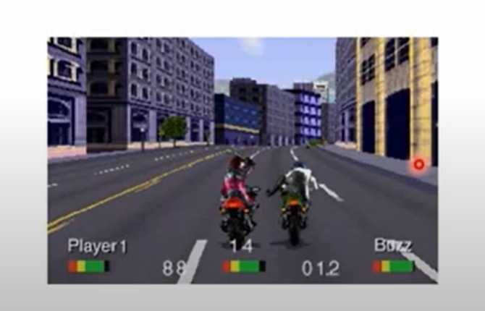
Real Time Example

Slide 59
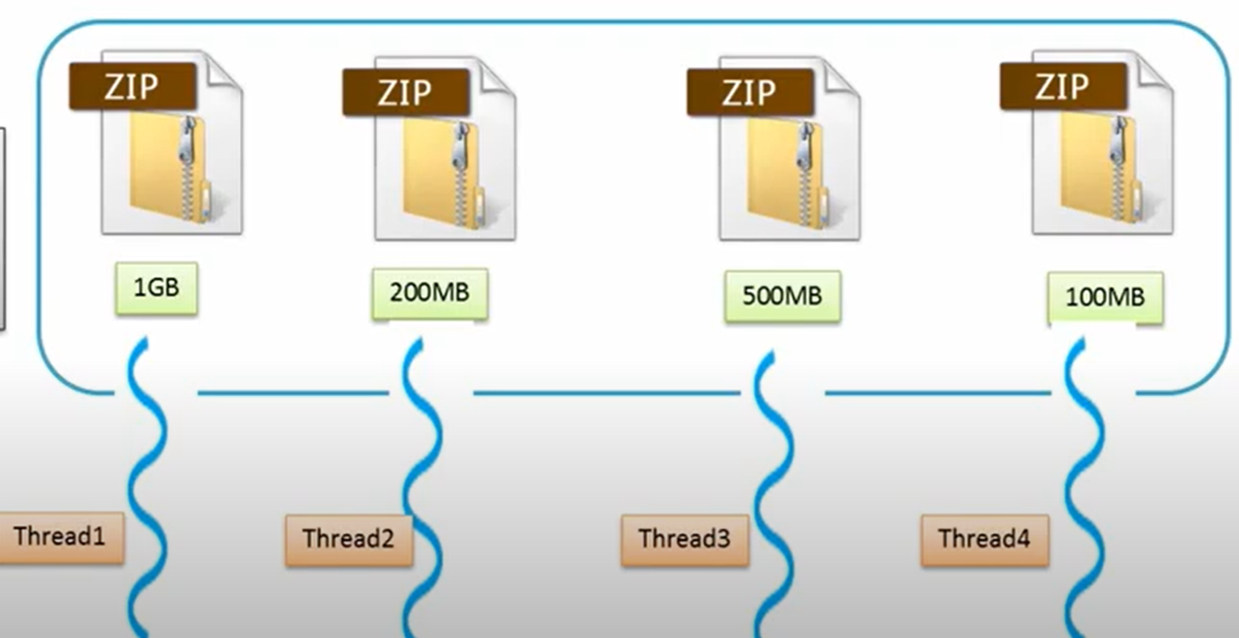
Another Example

Slide 60
Collections
What is Collections?
The Collection in Java is a framework that provides an architecture to store and manipulate the group of objects. Java Collections can achieve all the operations that you perform on a data such as searching, sorting, insertion, manipulation, and deletion.
      Why Collections?
      To handle group of objects
      It provides dynamically growing or shrinking size whereas array cannot provide this because it is fixed size.

Slide 61
Wrapper Class
The wrapper class in Java provides the mechanism to convert primitive into object and object into primitive.
The automatic conversion of primitive into an object is known as autoboxing and vice-versa auto-unboxing.
Data Type | Wrapper Class
int | Integer
char | Character
float | Float
double | Double
long | Long
boolean | Boolean
 | String (Already class)

Slide 62
Collection Framework
Iterable
Collection
List
Queue
Set
Map
HashSet
HashMap
ArrayList
PriorityQueue
LinkedList
LinkedHashSet
LinkedHashMap
Dequeue
Vector
TreeSet
TreeMap
ArrayQueue
HashTable
Stack
Interface
Legend
Class

Slide 63
Generics
Generics are a powerful feature in Java that allows you to define classes, interfaces, and methods with type parameters. They enable type safety and reusability by ensuring that a collection or data structure works with specific types without requiring type casting.
Type Safety
List<String> list = new ArrayList<>();
list.add("Hello"); // Type-safe, only Strings allowed.
// list.add(123); // Compile-time error.

Slide 64
Generics
Eliminates Type Casting:
Without generics, type casting is required when retrieving objects from collections.
Ex:
  List list = new ArrayList();
  list.add("Hello");
  String str = (String) list.get(0); // Manual casting required.

Slide 65
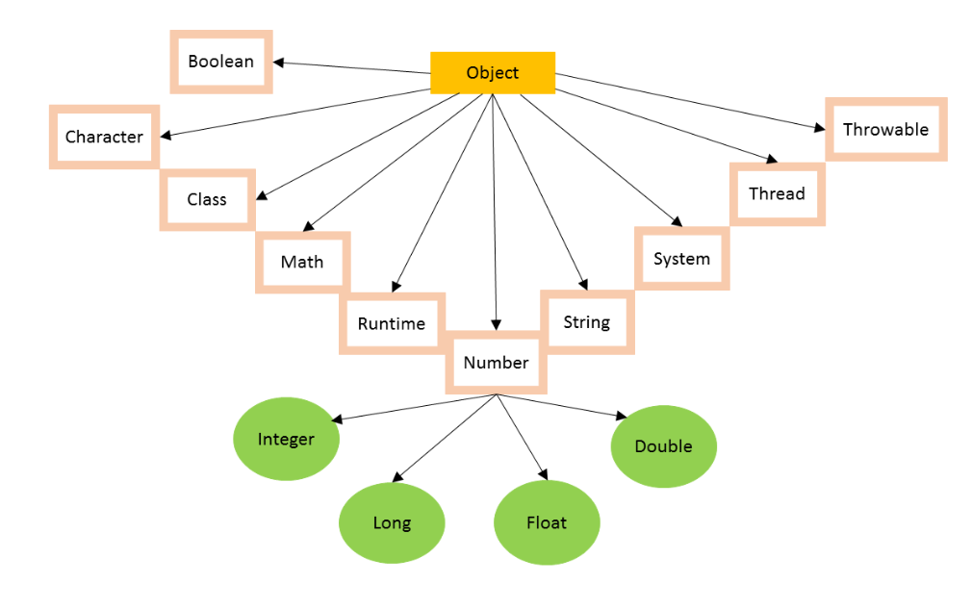
Object Class Hierarchy

Slide 66
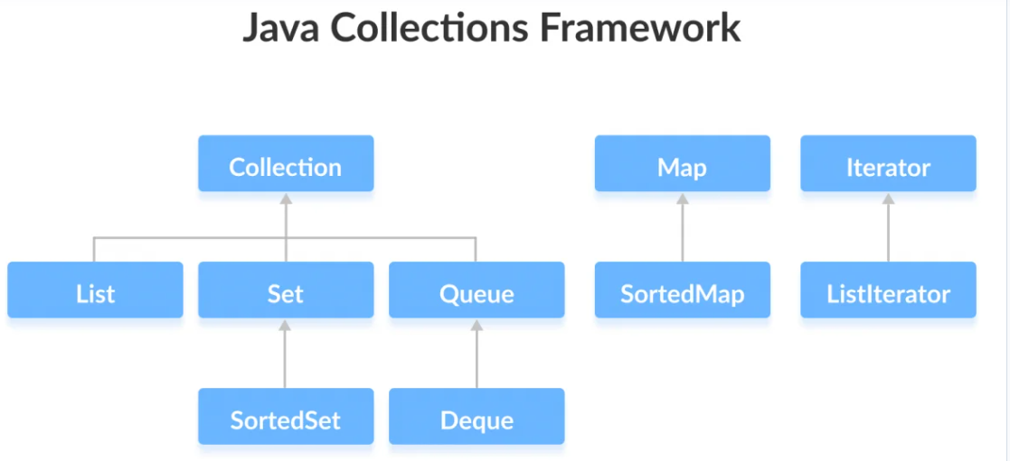

Slide 67
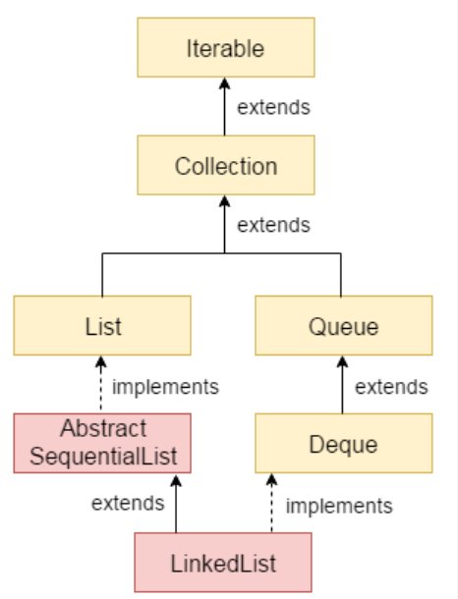

Slide 68
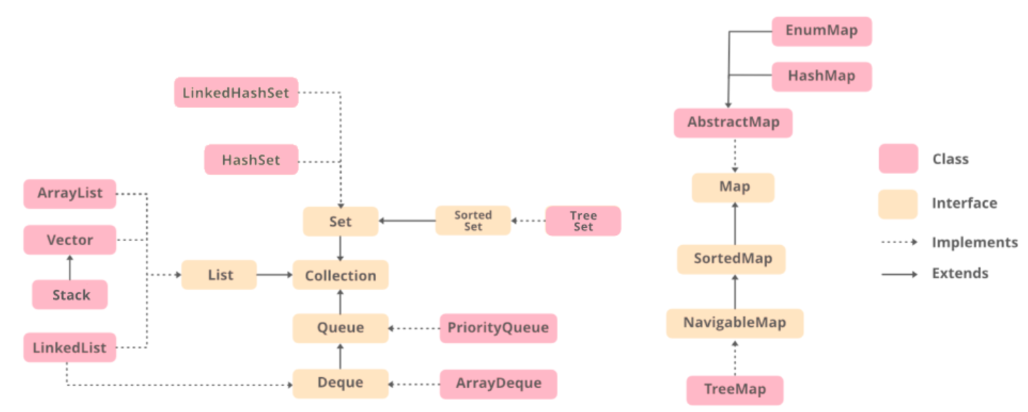

Slide 69
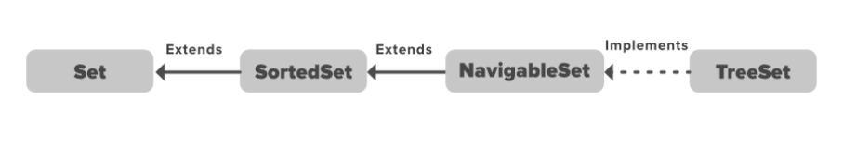

Slide 70
List vs Set vs Map
List | Set | Map
List maintains insertion order | Set does not maintain insertion order | May is Key Value pair. Insertion order depends upon which map we use.
List allows the duplicate | Set does not allow duplicate
Elements can be inserted at specified index | Elements cannot be inserted at specified Index. Because Set does not maintain index.

Slide 71
Vector Vs Stack
A Vector in Java is a part of the Java Collections Framework and is a dynamic array that can grow or shrink in size as needed. It is similar to an ArrayList but with two key differences: it is synchronized, and it contains many legacy methods that are not part of the collections framework
A Stack is in collection framework which implements list interface and extends Vector class. It is based on the basic principle of last-in-first-out (LIFO). It has two basic operations called push and pop which is used to insert and remove the elements. In addition to that it also provide few more operations empty, search and peek opeations.

Slide 72
Vector Vs Stack
Key Differences
Feature | Vector | Stack
Data Structure | Dynamic array | LIFO (extends Vector)
Access | Random access by index | Access only to the top element
Order | Preserves insertion order | LIFO (Last In, First Out)
Usage | General-purpose, thread-safe | LIFO-based operations
Thread Safety | Synchronized | Synchronized (inherits from Vector)
Modern Alternative | ArrayList | Deque (such as ArrayDeque)

Slide 73
Stack Vs Vector
Key differences:
Order of elements: Stack (LIFO) vs. Vector (maintains insertion order).
Access method: Stack (push/pop) vs. Vector (get/set).
Synchronization: Both are synchronized, but Stack is more efficient.
Resizeability: Vector is resizable, while Stack has fixed size or overflow handling.
When to use:
Stack:
  - Evaluating postfix expressions.
  - Implementing recursive algorithms.
  - Parsing.
  - Backtracking
  2. Vector:
  - Dynamic memory allocation.
  - Random-access requirements.
  - Array-like operations.

Slide 74
Deque
The Deque is related to the double-ended queue that supports adding or removing elements from either end of the data structure
Therefore, a deque can be used as a stack or a queue. We know that the stack supports the Last-In-First-Out (LIFO) operation, and the operation First-In-First-Out is supported by a queue. As a deque supports both, either of the mentioned operations can be performed on it.

Slide 75
Autoboxing and Auto Unboxing
Autoboxing is the automatic conversion that the Java compiler makes between the primitive types and their corresponding object wrapper classes. For example, converting an int to an Integer, a double to a Double, and so on. If the conversion goes the other way, this is called unboxing.

Slide 76
Collections
Iterator:
‘Iterator’ is an interface which belongs to collection framework. It allows us to traverse the collection, access the data element and remove the data elements of the collection.
java.util package has public interface Iterator and contains three methods:
boolean hasNext(): It returns true if Iterator has more element to iterate.
Object next(): It returns the next element in the collection until the hasNext()method return true. This method throws ‘NoSuchElementException’ if there is no next element.
void remove(): It removes the current element in the collection. This method throws ‘IllegalStateException’ if this function is called before next( ) is invoked.

Slide 77
List vs Set vs Map
List
Set
Map
It is list of elements
It is ordered collection of elements
It allows duplicate values
New items can be inserted anywhere in between the list
It is set of elements
It is not ordered collection of elements
It does not allows duplicate values
New items can not be inserted anywhere in between the set
It is Key-Value pair of elements
Insertion order is depends on what class is implemented
If duplicate key is given, it will be overridden.
HashMap allows one null key and multiple null values. But HashTable does not allow null key and null value.

Slide 78
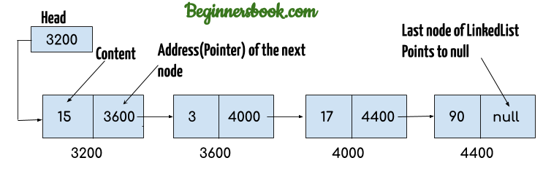
Linked List
3316

Slide 79
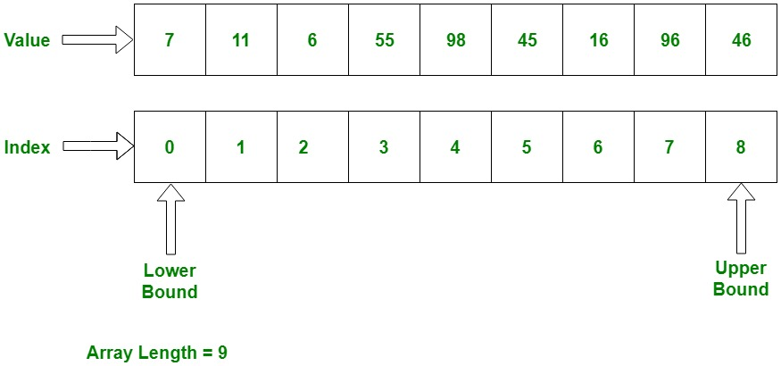

Slide 80
Read and Write Text File
      Ways to read data from the file
BufferedReader br = new BufferedReader(new FileReader(file));
FileReader fr = new FileReader("C:\\Users\\pankaj\\Desktop\\test.txt");
Scanner sc = new Scanner(file);
InputStreamRead isr = new InputStreamReader();
      Ways to write data to the file
BufferedOutputStream bos = new BufferedOutputStream(new FileWriter(file));
FileOutputStream outputStream = new FileOutputStream("c:/temp/samplefile4.txt");
DataOutputStream dataOutStream = new DataOutputStream(new BufferedOutputStream(outputStream));

Slide 81
Read and Write Excel File
      Apache POI – Read Write Excel File
      What is Apace POI?
        Apache POI (Poor Obfuscation Implementation) is a Java API for reading and writing Microsoft Documents in both formats .xls and .xlsx.
HSSF (Horrible SpreadSheet Format) Implementation: It denotes an API that is working with Excel 2003 or earlier versions.
XSSF (XML SpreadSheet Format) Implementation: It denotes an API that is working with Excel 2007 or later versions.

Slide 82
JDBC
There are 5 steps to connect any java application with the database use JDBC
Register the Driver class
Create connection
Create statement
Execute queries
Close connection

Slide 83
JDBC
Class.forName("com.mysql.jdbc.Driver");
Connection con=DriverManager.getConnection(
"jdbc:mysql://localhost:3306/sonoo","root","root");
//here sonoo is database name, root is username and password
Statement stmt=con.createStatement();
ResultSet rs=stmt.executeQuery("select * from emp");
while(rs.next())
System.out.println(rs.getInt(1)+" "+rs.getString(2)+" "+rs.getString(3));
con.close();

Slide 84
BLOB and CLOB
BLOB
Binary Large Object. It stores the binary data up to 2GB of size. This helps to store the image file, voice data.
CLOB
Character Large Object. It stores the character up to 2GB of size.

Slide 85
BLOB and CLOB
BLOB | CLOB
The full form of Blob is Binary Large Object. | The full form of Clob is Character Large Object.
This is used to store large binary data. | This is used to store large textual data.
This stores values in the form of binary streams. | This stores values in the form of character streams
Using this you can stores files like videos, images, gifs, and audio files. | Using this you can store files like text files, PDF documents, word documents etc.

